Slide 1

WELCOME TEACHERS
TO CLASS 3D
Teacher: Cao Thi Dat

Slide 2
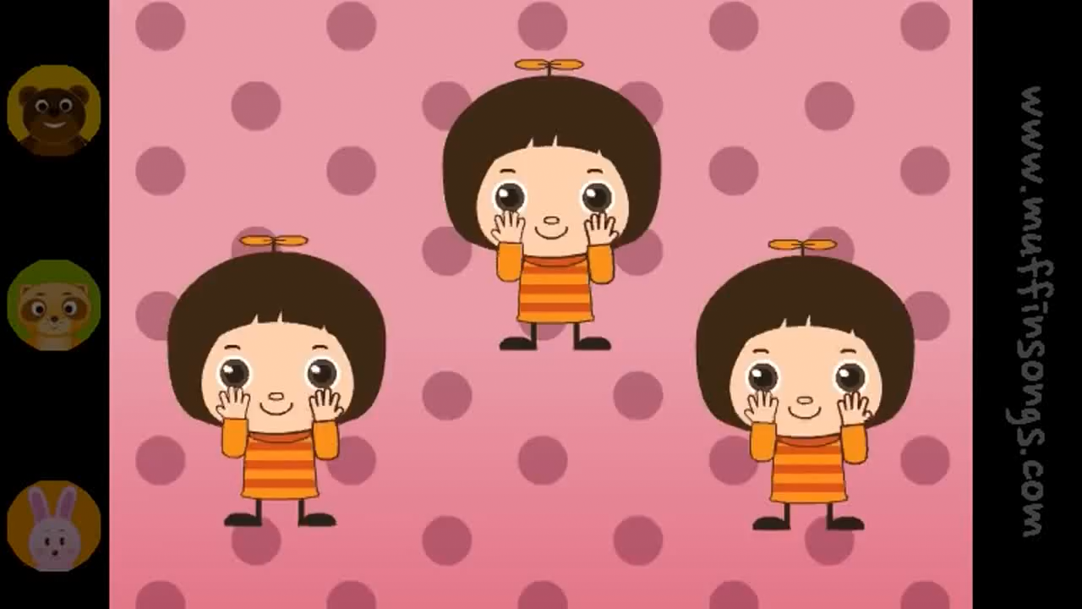
Sing “Hello” song

Slide 3
GAME
JUMBLED WORDS

Slide 4





0. o y t
$$toy
1. o u s h e
$$\text{house}$$
2. u s e m o
$$mouse
3. i p s h
$$\text{ship}$$
4. l a n p e
$$\text{plane}$$

Slide 5
Monday March 9th 2015
Unit 16:
Do you have any pets?
Lesson 1 (1,2,3)

Slide 6


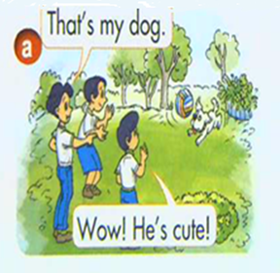

Slide 7
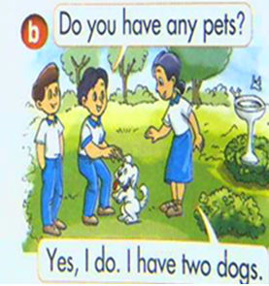

Slide 8
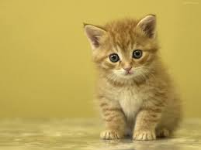
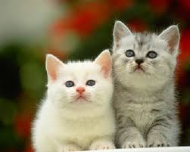

Slide 9
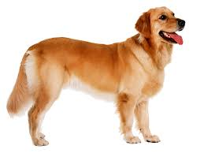
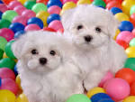

Slide 10
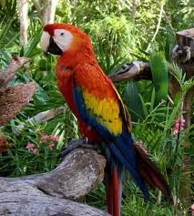
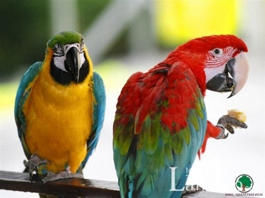

Slide 11
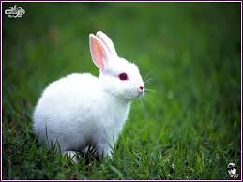
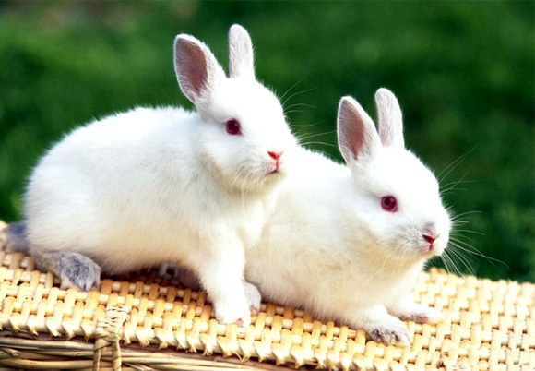

Slide 12
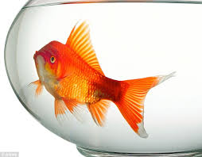
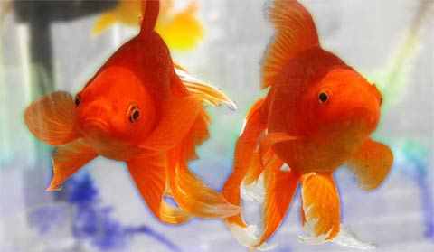

Slide 13
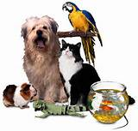
pets

Slide 14
New words
a cat
cats
a dog
dogs
a parrot
parrots
a rabbit
rabbits
a goldfish
goldfish
Structure
Do you have any pets?
Yes, I do.
No, I don't.

Slide 15
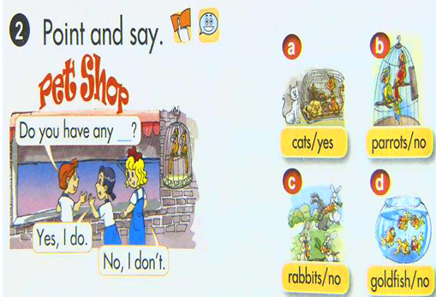

Slide 16
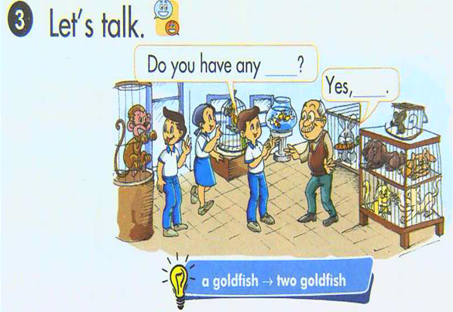

Slide 17


Lucky stars
1
2
3
4
5
6
7
8
9
Group 1
Group 2

Slide 18
Homework
-Practice model about :Have

Slide 19
GOODBYE
THANK YOU FOR
YOUR ATTENTION

